Slide 1
Fifth Grade
Parent Orientation
2023-2024

Slide 2
Student’s Assignment Binder
Yellow folder- Left Pocket - Homework/Return to School
Yellow folder-Right Pocket – Graded Papers/Keep at Home
Blue and Yellow Folders in the binder – ongoing classwork
Travels with student between home and school daily

Slide 3
Incentives
This year we are implementing Cub Cash. Your child can earn this for being an exemplary student, following directions, going above and beyond or just being helpful.
Students can “cash” it in for school wide rewards or keep it for the end of the year auction that is held in the classroom.

Slide 4
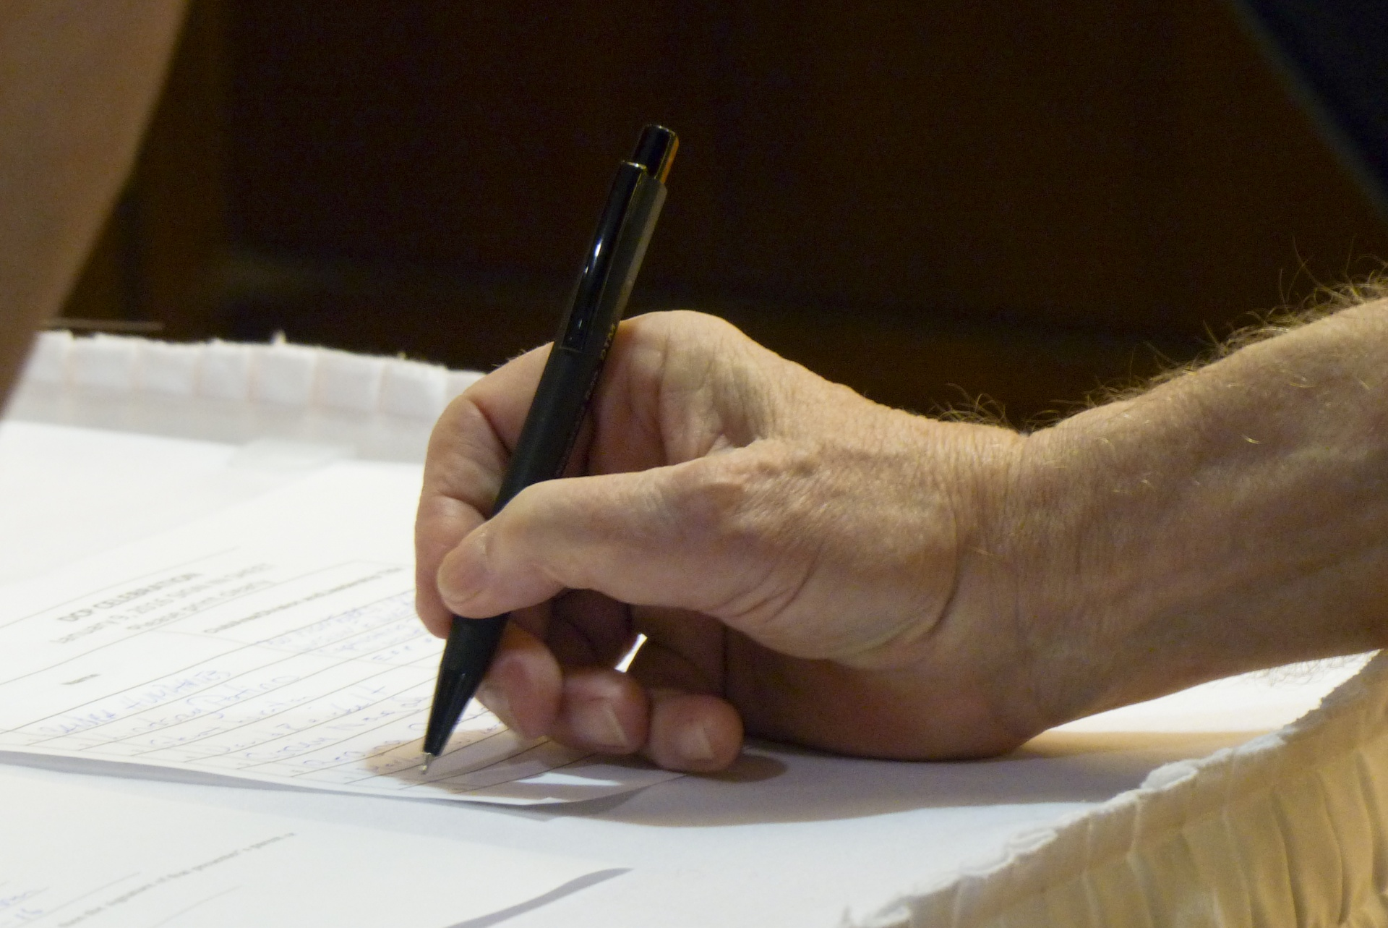
BISD Grading Policy
A failing grade is anything below 70.
Daily work and quizzes can be corrected for up to a 70. The corrections need to be done at home and turned in by the due date listed. Students who fail a test will have an opportunity to make corrections after a reteach.

Slide 5
Testing
Istation/MAP testing
District assessments
STAAR testing:
Reading- April 16th
Science-April 23rd
Math- April 30th

Slide 6
Skyward
Your password is the same from last year.
If you are experiencing any problems, please contact the office.
Grades will be posted here
Keep updated if/when contact information changes

Slide 7
Fifth Grade Information and Communication
Newsletter is sent home via email every Friday
Please make sure you signed up for Remind. Text the message @kcha87 to the number 81010.
The newsletter can be accessed on teacher’s CCES teacher webpage
Please review the information on the newsletter with your child so they stay up-to-date with class and campus happenings
The yellow communication folder should go home daily with their binder.
Succeed Math books- They will go home with every student at the beginning of each module and they are for you to work with your child at home. It is extra practice and they do not need to be returned to school.

Slide 8
Birthdays
We love celebrating your kiddos special day with them!
Please remember to send either napkins or paper towels along with the treat.
Treats must be store bought/individually wrapped

Slide 9
Emergencies
For any changes in your child’s normal transportation or any urgent notifications, please contact the front office.
We sometimes are unable to check our emails or phone messages until the end of the day. The office will get us the necessary information, to update your child.

Slide 10
Dress Code
• Hairstyles or designs that are disruptive or distracting to the school environment are prohibited (i.e. mohawks, rattails, patterns or shavings in the hair, or spikes). Color that is disruptive or distracting to the school environment is prohibited (i.e. colors other than natural hair colors).
• Shorts, skirts, skorts, or dresses must reach mid-thigh range or longer. Shorts of any style must have at least a 4 inch inseam. The same standard applies to slits or slashes in shorts, skirts or dresses. A shirt worn over leggings must meet length requirements for dresses.
• Shirts and dress tops must have straps and must be worn on the shoulders. Undergarments should not be visible. Midsection may not be exposed. Excessively large armholes are prohibited.
• No hats or hoods can be worn.

Slide 11
Absences
Within three days of your child being absent, please send an email or note. Without a note, the absence is considered unexcused.
Volunteer Opportunities
Room Parent
Asst Room Parent
Cub Crawl basket
Please speak to your child’s homeroom teacher if you are interested.

Slide 12
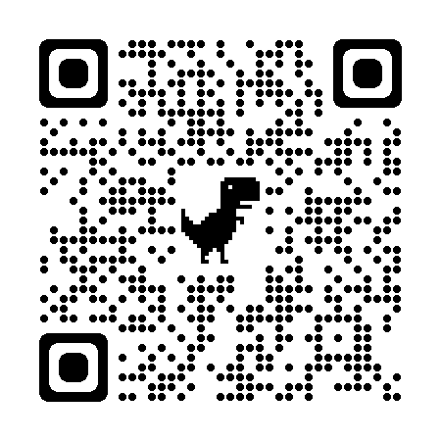
Classroom Volunteers:
If you would like to help with being a room parent, assistant room parent or the class basket for Cub Crawl, please visit,
https://www.signupgenius.com/go/805084DA4A92CA3F49-2023

Slide 13
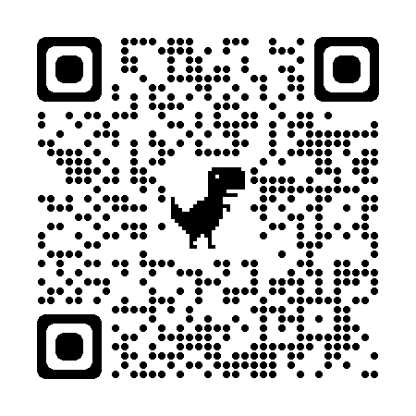
Committee Volunteers
If you would like to help with PTO and serve on a committee, please visit,
https://www.signupgenius.com/go/805084DA4A92CA3F49-20231

Slide 14
Upcoming Events
Boerne Outdoor Academy (B.O.A.) - February 28-March 1
Cub Crawl - October 27th
Business Fair - Dec. 14th; more information to come, as we get closer
5th Grade Promotion - May 23rd

Slide 15
We’re so happy to get to work with your child and your family!
Questions???
Session 1: 5:30-5:55 p.m. Session 2: 6:00- 6:25 p.m.

